Slide 1
Evidence that mutations in the CLN3 gene cause failed oxidative stress response and contribute to Batten disease in Drosophila
An thorough analysis of Tuxworth et al.’s 2011 article.
Ali Okihiro
BIOL 506
Wednesday November 28, 2011
Tuxworth, R.I., Chen, H., Vivancos, V., Carvajal, N., Huang, X., and G. Tear. (2011). The Batten disease gene CLN3 is required for the response to oxidative stress. Human Molecular Genetics, 20(10); 2037-2047.

Slide 2
Outline
Introduction to Batten disease and the CLN3 gene
Objectives of the research
Experimental Approach and Results
Conclusion/Discussion
Future research
Critique
Questions

Slide 3
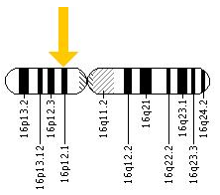
Introduction
Neuronal ceroid lipofuscinosis disorders (NCLs)
Neurodegenerative diseases
Early childhood onset
Abnormal lipofuscin accumulation
Juvenile NCL (or Batten disease)
The most common NCL
Autosomal recessive inherited mutation
CLN3 gene (Chromosome 16)
Battenin - Important in brain neuron survival
http://ghr.nlm.nih.gov/gene/CLN3

Slide 4
Previous Studies with CLN3
CLN3 encodes a hydrophobic transmembrane protein of unknown function
Endocytosis?
Protein trafficking?
Mitochondrial function?
Lysosomal function?
Previous studies by Tuxworth et al. (2009)
inactive CLN3 protein causes degenerative eye and wing phenoype in Drosophila model

Slide 5
Objective
To determine the cellular processes affected by loss of CLN3
Insight to CLN3 function
Determine how CLN3 loss leads to neurodegeneration

Slide 6
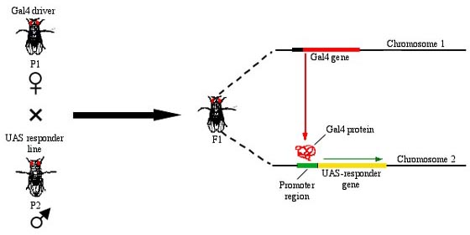
The Drosophila Model
Contains orthologs for 4 of the 10 human genes associated with Batten disease
Biological processes and pathways are generally conserved
UAS-GAL4 system
http://www.clas.ufl.edu/jur/200312/papers/paper_lanata.html

Slide 7
Experimental Approach and Results
Identify potential interacting partners for CLN3
Candidates were previously examined by Tuxworth et al. (2009)
List of genes that are able to modify wing and eye phenotype
Identify more partner genes
Gain of Function screen
1574 EY P-element insertions (containing UAS) on chromosome 3 expressed with an overexpression CLN3 phenotype
Assess the modification to dominant CLN3 phenotypes
Suppressors and Enhancers

Slide 8
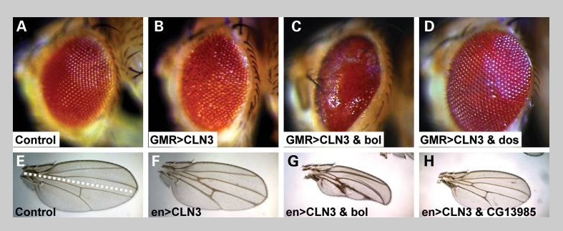
Figure 1
14 insertions enhanced eye phenotype only
19 insertions enhanced wing phenotype only
14 insertions suppressed eye phenotype only (D)
1 insertion suppressed wing phenotype only (H)
7 insertions enhanced both wing and eye phenotype (C and G)

Slide 9
Experimental Approach and Results
Determine the biological processes associated with the partner genes
A major group of these genes are involved in the stress signalling response
P38 MAP kinase stress signaling response
JNK stress signaling response
Verify that CLN3 phenotype is mediated by stress response pathways
Overexpress CLN3 and foxo (transcriptional factor) together

Slide 10
Figure 2
Foxo – a forkhead transcription factor involved in the JNK stress-induced pathways
Overexpression of foxo and CLN3 together produce a severe phenotype compared to overexpression of foxo and CLN3 alone

Slide 11
Figure 2
Falafel suppresses the overexpressed CLN3 phenotype (E)
Keap1 heterozygote suppresses the overexpressed CLN3 phenotype (F)
SOD (superoxide dismutase) suppresses the overexpressed CLN3 phenotype (G)
Catalase suppresses the overexpressed CLN3 phenotype (H)

Slide 12
Experimental Approach and Results
cln3 mutant development
1534 bp deletion
Naïve mutants were visually void of abnormalities
Wild type flies and cln3 mutants were treated with 3 different forms of oxidative stress
Hydrogen peroxide (HP), Diethylmaleate (DEM), Paraquat (PQ)
CLN3 re-expression rescue

Slide 13
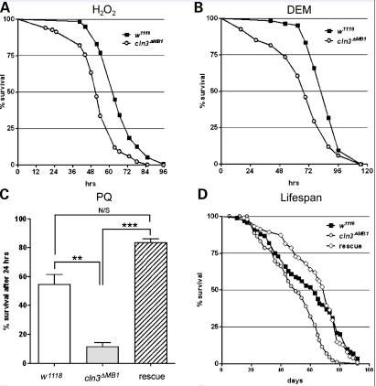
Figure 3
cln3 mutants have a shorter lifespan compared to wild type flies when treated with oxidative stressors
Rescue CLN3 re-expression restores cln3 mutant function

Slide 14
Experimental Approach and Results
Determine if cln3 mutants are hypersensitive to other environmental stresses
Thermal stress
Recovery from a cold-induced coma
657 s wild type; 660 s cln3 mutant
Starvation
Osmotic stress during development

Slide 15
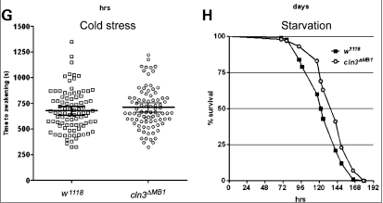
Figure 3
No significant difference between wild type and cln3 mutant flies when exposed to non-oxidative stresses.

Slide 16
Experimental Approach and Results
Determine if expression of CLN3 in Dilp neurons confers resistance to oxidative stress
Dilp2 protein is involved in the JNK stress-signalling pathway (previous studies)
Previous studies by Tuxworth et al. (2009) show CLN3 is involved in the JNK signaling
Lifespan assay
CLN3 overexpression only, Dilp2 heterozygote only, Dilp2>CLN3

Slide 17
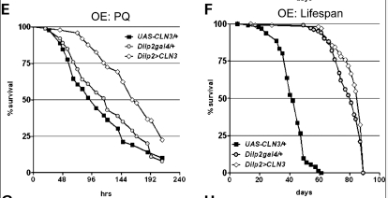
Figure 3
Dilp2>CLN3 flies have increased resistance to paraquat (PQ) oxidative stress.
Dilp2>CLN3 flies show a significant increase in lifespan vs. Dilp2gal4 heterozygote and overexpressed CLN3

Slide 18
Experimental Approach and Results
Determine why the cln3 mutants are hypersensitive to oxidative stress
Failure to detoxify ROS (reactive oxygen species) accumulation
GFP promoter used to identify if antioxidant response is triggered in cln3 mutants
GFP is produced in response to oxidants in Malpighian tubules
Malpighian tubules – analogous function to the human kidney (detoxification)

Slide 19
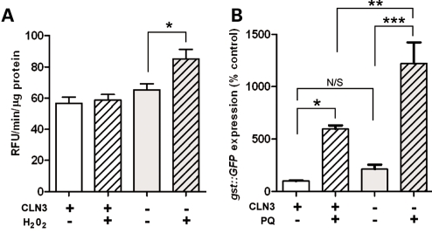
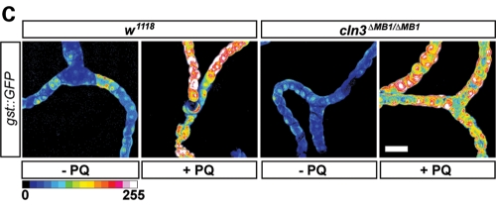
Figure 4
There is an increased accumulation in ROS in cln3 mutants after exposure to hydrogen peroxide
GFP promoter to antioxidant response is expressed in cln3 mutants after exposure to PQ

Slide 20
Experimental Approach and Results
Determine if CLN3 expression is upregulated by oxidative stress
Tuxworth et al. determined that CLN3 is highly expressed in Malpighian tubules (unpublished)
Antibody detection western blot on whole fly lysates
24 hour-old VenusCLN3 flies engineered to express CLN3 in Malpighian tubules
GFP used immediately upon Malpighian tubule treatment and dissection

Slide 21
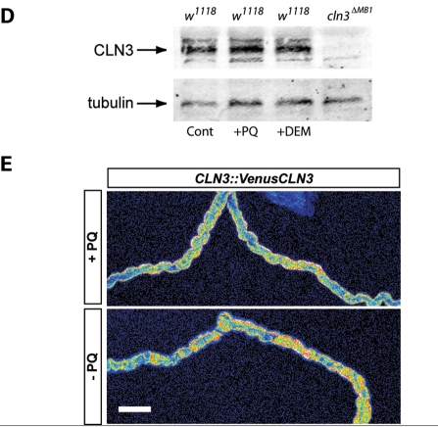
Figure 4
CLN3 antibody shows no increase in protein level
Malpighian tubules exhibit no significant difference in CLN3 expression

Slide 22
Conclusion/Discussion
CLN3 is involved in the oxidative stress response
CLN3 is not involved in thermal, starvation or osmotic stress responses
CLN3 is necessary in oxidative stress response
ROS accumulates in cln3 mutants exposed to oxidative stress
However, cln3 mutants are still able to signal transcription of antioxidant genes
CLN3 protein is not upregulated by oxidative stress
Theory: CLN3 may be constitutively expressed

Slide 23
Future Work
Determination the mechanism that inhibits ROS from being detoxified in cln3 mutants
Use of a different model system
Mouse model
CLN3 knockout mouse
Behavioral studies
Determine whether CLN3 is constitutively expressed
If so, in what tissues?

Slide 24
Critique
Tuxworth et al. did not examine the pathways of all the CLN3 overexpression modifiers
What other pathways, besides stress-signaling, are associated with CLN3 protein?
No connection between ROS and degeneration of neurons
Used an overexpression CLN3 model to show enhancement and suppression of the phenotype
It would have been interesting to see what suppression of wild type CLN3 looks like

Slide 25
Questions

